Slide 1
MEASURES OF DATA

Slide 2
MEASURES OF DATA
A- Measures of central value value (tendency)
B- Measures of variance (dispersion)

Slide 3
a. Measures of central value
Concept that has to do with the centre of a distribution

Slide 4
Measures of central value : Median
The value that divides a distribution in half.
If the observations are arranged in increasing order, the median is the middle observation.
If there are an even number of observations the median is calculated as the mean of the 2 middle values.
A general expression :
Median = (n+1) ^{th} value of the ordered observation 2

Slide 5
Median
Data 1
12 0 5 13 0 0 5 10 5 1 5 6 7 5 7 8 10 5 11 14 11
Data 2
0 0 0 1 5 5 5 5 5 5 6 7 7 8 10 10 11 11 12 13 14
Data 3
0 0 0 1 5 5 5 5 5 5 6 7 7 7 8 10 10 11 11 12 13 14
Median = (6+7)/2 = 6.5

Slide 6
Measures of central value : Mean
is the sum of the observations divided by n, the number of observations.
If the observations are denoted x₁ x₂ … x_{n} then the mean is denoted by and
The formula for the mean is: = Σx_{i} / n.

Slide 7
Measures of central value : Mode
This is the most frequently occurring value
E.g
0 0 0 1 5 5 5 5 5 5 6 7 7 8 10 10 11 11 12 13 14

Slide 8
Library books illustration
Students borrow and return books from a university library regularly
One student borrows a book and forgets to return it
They re-discover the book 2 years later when moving out of the student accommodation and decide to return the book.
What do you think will happen to the mean and median of a data set on borrowing periods?

Slide 9
Measures of central value
In summary: Mean:
The mean is the preferred measure of central tendency when describing a data that do not have outliers.
A major disadvantage is that it is affected by outliers (i.e. single observations which are very extreme compared with most observations and whose inclusion or exclusion changes results noticeably).

Slide 10
Measures of central value
In summary: Median:
In the absence of outliers, the median is the preferred measure of central tendency.
Disadvantage
Calculation of the median does not involve the use of all available data and is therefore is less statistically efficient (i.e., has less statistical power) than the mean.

Slide 11
Measures of dispersion
Dispersion = variation

Slide 12
b. Measures of dispersion
They give us an idea of the variation or spread of values around the central one.
How much numbers in a distribution differ from each other

Slide 13
Measures of dispersion : Range
The interval between the largest and smallest
based on only two observations and gives no idea of how the observations are arranged between these two.
For example, years of schooling was recorded for the men in two different groups and the results are shown below:
Group 1 : 0 0 0 0 0 0 0 1 1 1 2 2 3 3 3 3 3 8 10 11 14
Group 2 : 0 0 0 1 5 5 5 5 5 5 6 7 7 8 10 10 11 11 12 13 14

Slide 14
Measures of dispersion : Inter Quartile Range (iqr)
Shows spread of the middle 50% of the distribution
IQR = 75th percentile -25th percentile
Group 1 : 0 0 0 0 0 0 0 1 1 1 2 2 3 3 3 3 3 8 10 11 14
Ex 1 in a dataset the 75th percentile is 8 and 25th percentile is 6. what is the IQR?
Ex 2 in a dataset the 75th percentile is 9 and 25th percentile is 5. what is the IQR?
Which dataset has greater spread?

Slide 15
Measures of dispersion : Inter Quartile Range (iqr)
Shows spread of the middle 50% of the distribution
IQR = 75th percentile -25th percentile
Ex 1 in a dataset the 75th percentile is 8 and 25th percentile is 6. what is the IQR?
Ex 2 in a dataset the 75th percentile is 9 and 25th percentile is 5. what is the IQR?
Which dataset has greater spread?

Slide 16
Measures of dispersion : Inter Quartile Range (iqr)
Shows spread of the middle 50% of the distribution
IQR = 75th percentile -25th percentile
Ex 1 in a dataset the 75th percentile is 8 and 25th percentile is 6. what is the IQR?
Ex 2 in a dataset the 75th percentile is 9 and 25th percentile is 5. what is the IQR?
Which dataset has greater spread?

Slide 17
Measures of dispersion : Inter Quartile Range (iqr)
Shows spread of the middle 50% of the distribution
IQR = 75th percentile -25th percentile
Ex 1 in a dataset the 75th percentile is 8 and 25th percentile is 6. what is the IQR?
Ex 2 in a dataset the 75th percentile is 9 and 25th percentile is 5. what is the IQR?
Which dataset has greater spread?

Slide 18
Box plots

Slide 19
Measures of dispersion : variance
Can be defined in terms of how close the scores are to the middle of the distribution(mean)
This variability or variance can be measured in terms of how far observations are from the mean on average i.e. how far, on average, each observation deviates from the mean.
variance = by dividing the sum of squares of these deviations by (n‑1).
The formula for the variance is: Σ(x_{i} - x)² / (n-1).

Slide 20
Measures of dispersion : Standard deviation
Standard Deviation (SD): A measure of the average spread of values about the mean.
It is usually more convenient to express the variation in terms of the original, unsquared units (e.g. grams), i.e. to take the square root of the variance.
This is then called the standard deviation (SD).
A small standard deviation indicates that most values lie very close to the mean

Slide 21
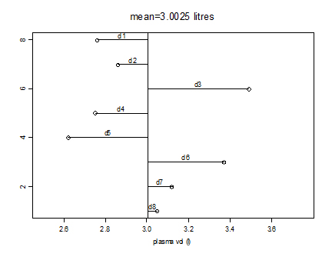
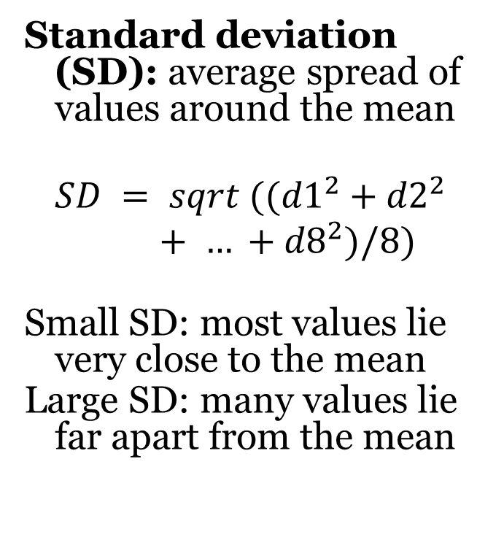
Standard deviation illustration
graph: deviations from the mean plasma volume
Standard deviation (SD): average spread of values around the mean
$$SD = sqrt (({d1}_{}^{2}+{d2}_{}^{2}+ … +{d8}_{}^{2})/8)$$
Small SD: most values lie very close to the mean
Large SD: many values lie far apart from the mean

Slide 22
Categorical data
The values of categorical variables represent labels denoting different categories, rather than actual measurements of some quantity
The frequency distribution of a categorical variable can be presented in a table or graph

Slide 23
Categorical data
Calculating percentages enables one to make comparisons between different groups.
In many instances, it will not make sense to calculate a mean or a standard deviation in an attempt to describe a categorical variable, such as race, gender, blood group, etc.

Slide 24
Example 1
Bar charts: display the distribution of categorical variables.
Example: distribution of marital status in HIV +ve and HIV –ve TB patients

Slide 25
Example 2 table
Frequency distribution: number of times each category occurs in the sample.
Example: marital status of 105 HIV positive TB patients
Marital status Number of HIV+ Percentage
patients
__________________________________________________________________________
Single 35 33.3
Married 59 56.2
Divorced 8 7.6
Widowed 3 2.9
__________________________________________________________________________
Total 105 100.0
__________________________________________________________________________

